Slide 1
Dichiarazione di invarianti
invariant name over id_function,...,id_rule : term

Slide 2
Primitive di AValLa
Set | A command to set the location of a (monitored) function to a specific value: it simulates the environment
Check | To inspect external values and (only for the observer ) to inspect internal values in the current state
Step | To signal that the environment has finished to update the monitored locations, hence the machine can perform a step
StepUntil | To signal that the machine can perform a step iteratively until a specified condition becomes true
Invariant | To state critical specification properties that should always hold for a scenario
Exec | To execute transition rule when required by the observer

Slide 3
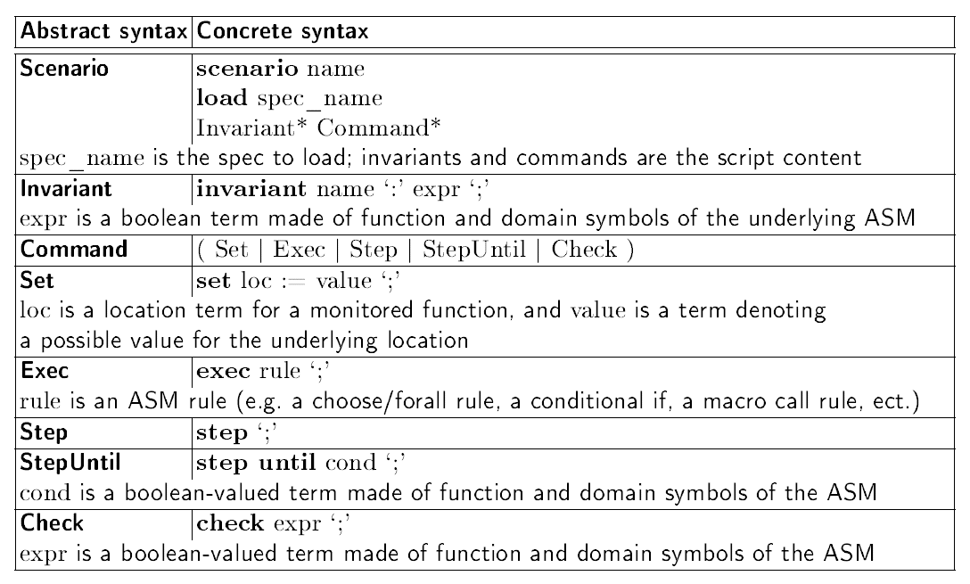
Sintassi dei comandi

Slide 4
template in Avalla
scenario name
load ./spec.asm
// ....setting
set …;
// machine execution
step until cond;
step
// check locations
check ...;

